Slide 1
Bazele inteligenței artificiale
Laborator – Grigore Ionuț

Slide 2
Reguli laborator
NOTA FINALA BIA = (NOTA LAB + NOTA EXAMEN)/2
Regulile sunt următoarele:
Vom avea 13 laboratoare
Maxim 2 absențe, recuperate în S14.
NOTA LAB = (T1 + T2)/2; T1 → S7; T2 → S13
T1 → materia din săptămânile 1-6, iar T2 → materia din săptămânile 8-12.
Nu se permit măriri ale notelor de la teste ☹ . Testele care nu au fost date, vor fi recuperate în S14.

Slide 3
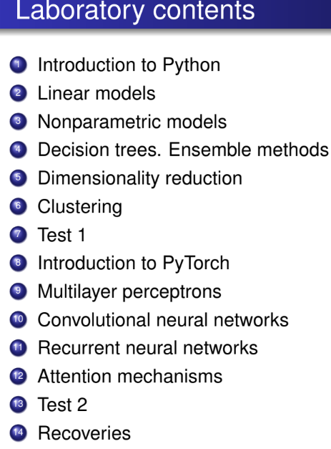
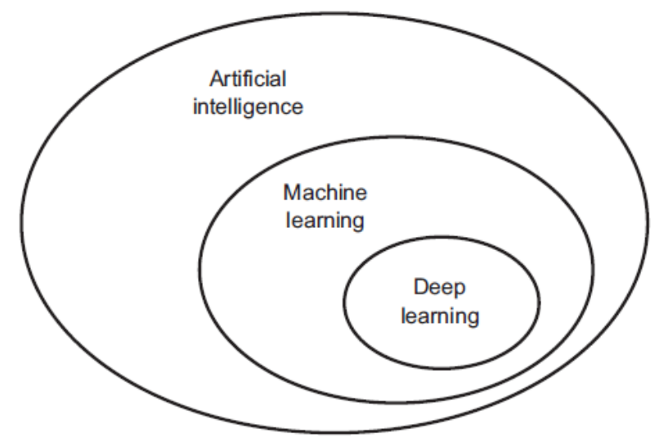
ML
DL

Slide 4
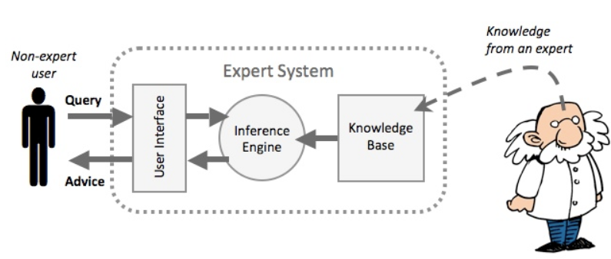
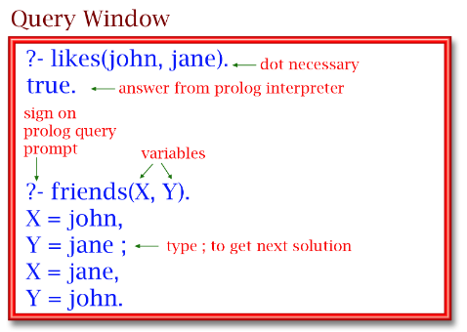
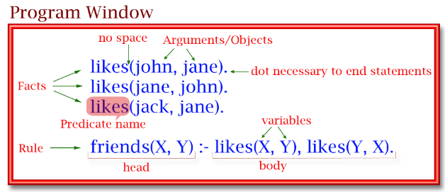












does not involve learning from data !
Example of problems:
Expert systems:
Logic Programming:
uses formal logic to express knowledge and solve problems by deriving logical conclusions
In Prolog, a logic programming language, you can define facts and rules to model a system. The system uses logical inference to derive new facts from the rules. There is no learning from data involved—everything is explicitly programmed.
rule-based systems that mimic human decision-making
Mycin, an early AI system used for diagnosing bacterial infections and recommending antibiotics. It was based on predefined rules created by human experts, and the system would infer conclusions based on those rules. There is no learning involved—just following if-then logical rules.

Slide 5
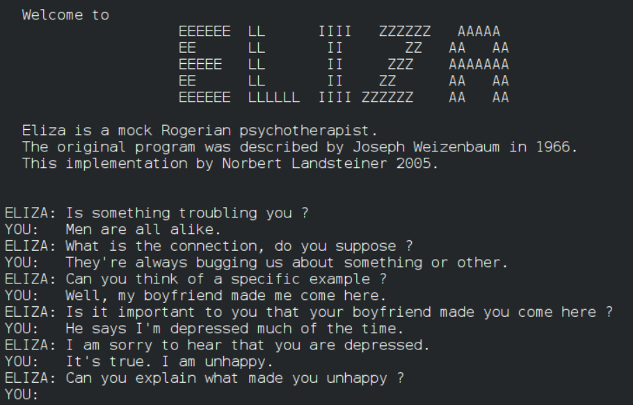
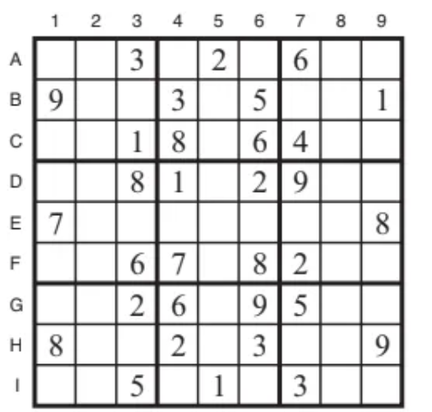












does not involve learning from data !
Example of problems:
Natural Language Processing (NLP) with Rule-Based Systems:
Constraint Satisfaction Problems (CSPs):
a type of problem where a solution must satisfy a set of constraints or limitations.
CSPs don’t learn from data; they solve by systematically checking possibilities under fixed rules
Sudoku – each row, column, and 3x3 block must contain numbers 1–9 without repetition
Understand and process human language using predefined rules.
Early chatbots like ELIZA, used simple pattern-matching rules to mimic human conversation. ELIZA did not learn from data but responded based on pre-programmed templates and keyword detection.
ELIZA did not improve with more conversations. It simply followed its predefined logic and patterns.

Slide 6
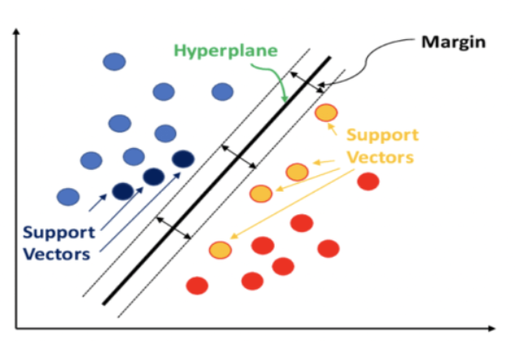
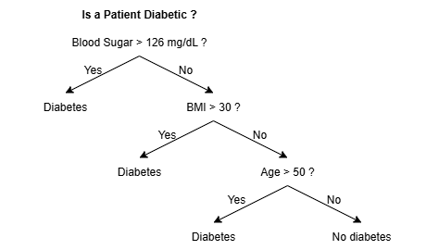



learn from data to make predictions or decisions!
Example of problems:
Decision Trees and Ensemble Methods (Random Forests, Gradient Boosting):
Support Vector Machines (SVM):
Decision trees split data based on feature values to make predictions.
Ensemble methods like Random Forests and Gradient Boosting combine multiple decision trees to improve accuracy and robustness.
Medical Diagnosis: predict whether a patient has diabetes based on features like blood sugar level, BMI, and age.
powerful classifiers that find the optimal hyperplane separating different classes in the feature space
Spam Detection, where SVMs classify emails as spam or not spam based on features like keyword frequency and sender information.
not
spam
spam

Slide 7
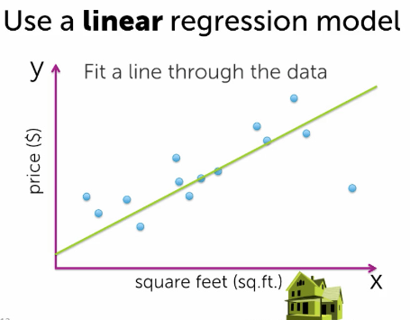
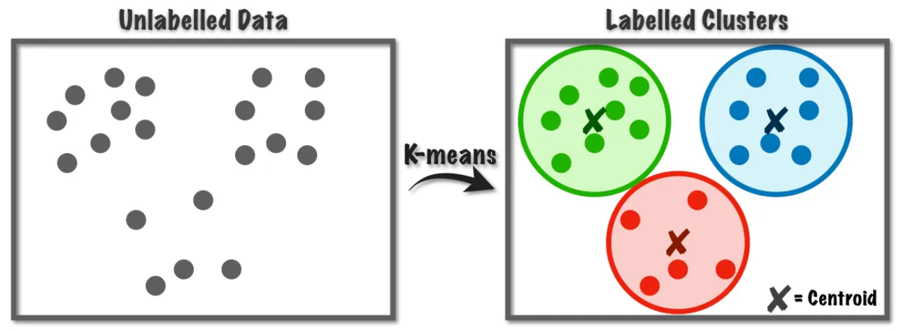




learn from data to make predictions or decisions!
Example of problems:
K-Means Clustering:
Linear and Logistic Regression:
a popular clustering algorithm that partitions data into K distinct groups based on feature similarity.
Customer Segmentation: group customers based on purchasing patterns for targeted marketing.
foundational ML techniques used for predicting continuous outcomes (linear regression) or categorical outcomes (logistic regression) based on input features.
House Price Prediction, where linear regression models factors like size, location, and number of bedrooms to estimate property prices.

Slide 8
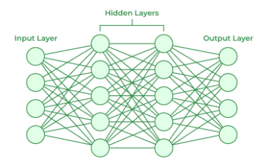
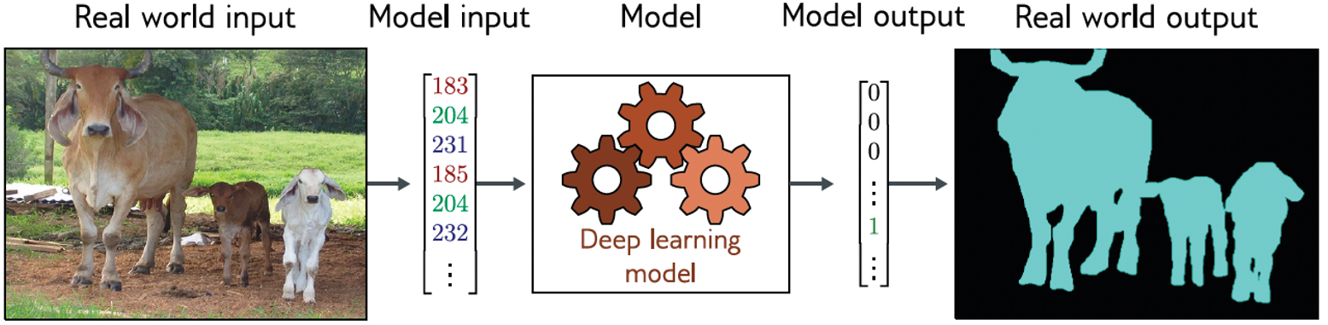
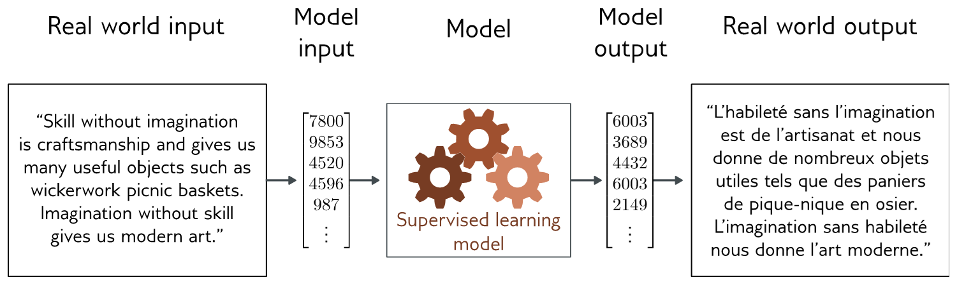
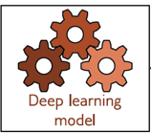
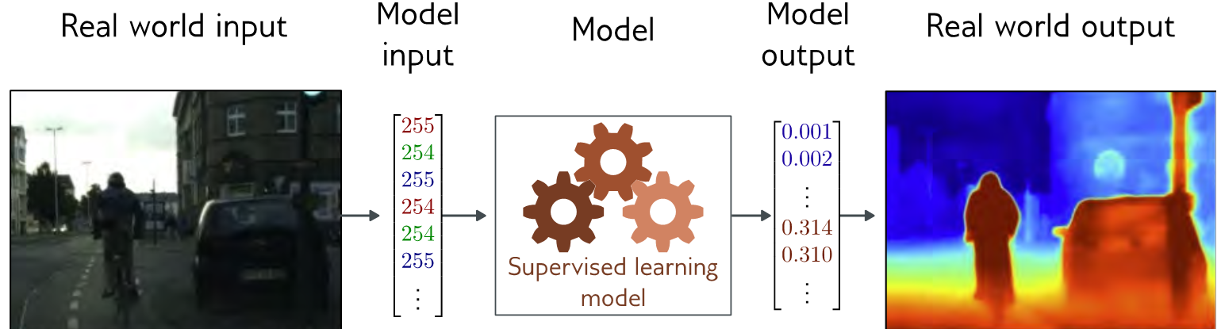
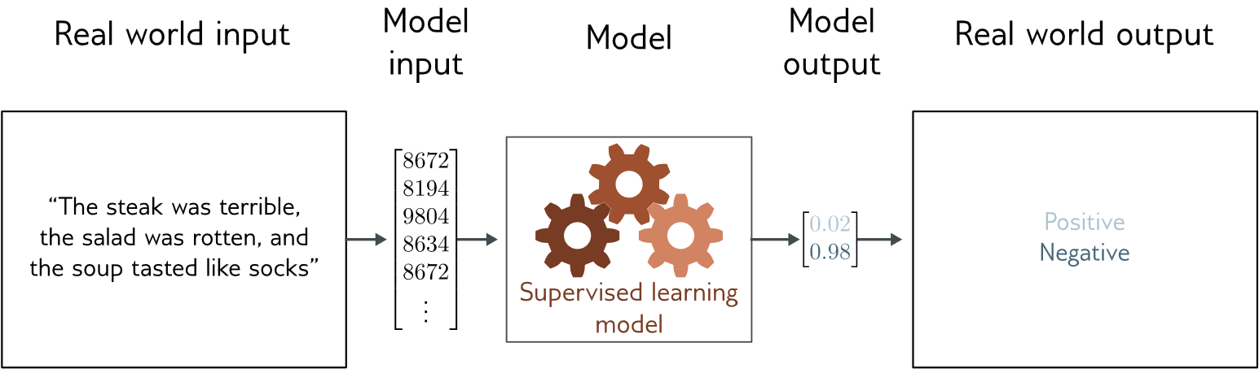
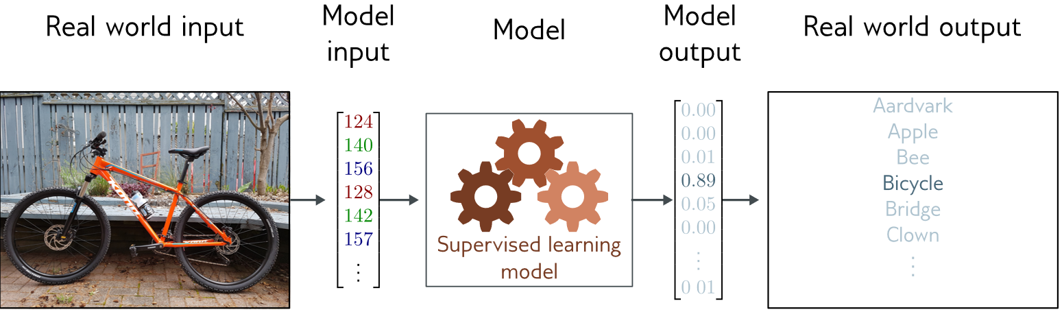


learn from data as in case of ML but works with (deep) neural networks:
Example of problems:
Image segmentation (semantic segmentation):
Translation:
Depth estimation:
Text classification:
Image classification:
NLP (natural language processing) – works with text
CV (computer vision) – works with images

Slide 9
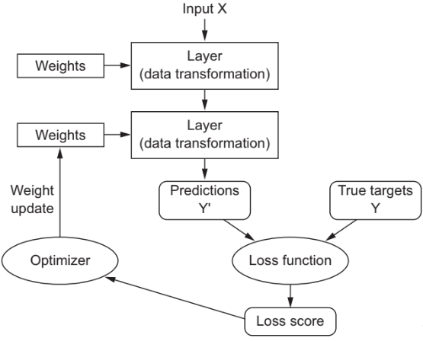
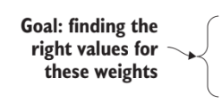

































does not involve learning from data !
learn from data to make predictions or decisions!
(the models are “TRAINED”!)
ML/DL
model

Slide 10














ML/DL
model
initially random
numbers
“alien”
“dog”
2.8 - high

Slide 11

ML/DL
model
slightly better
numbers
“wolf”
“dog”
0.9 - medium

Slide 12

ML/DL
model
very good
numbers
“dog”
“dog”
0.05 - low

Slide 13























TL;DR — AI vs ML vs DL — Key Differences
Artificial Intelligence (AI)
Broad field: systems that mimic human intelligence.
Does not learn from data (rule-based, expert systems, logic programming, CSPs).
Examples: ELIZA chatbot, Sudoku solver, Mycin.
Machine Learning (ML)
Subset of AI: learns from data to make predictions/decisions.
Uses algorithms trained on data → models improve with experience.
Examples: Decision Trees (medical diagnosis), SVMs (spam detection), Regression, Clustering.
Deep Learning (DL)
Subset of ML: uses neural networks with many layers.
Learns features directly from raw data (images, text, audio).
Examples: Image segmentation, Depth estimation, Translation, Sentiment analysis.

Slide 14
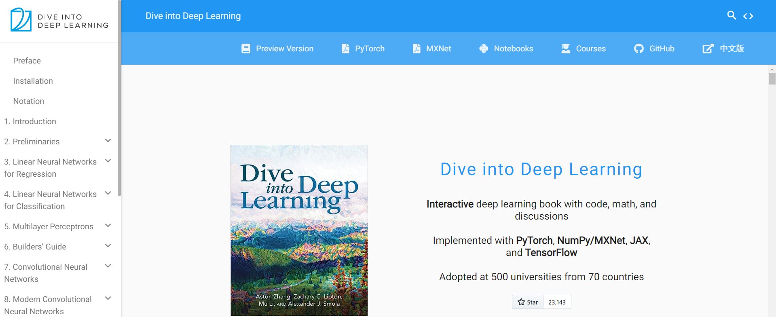
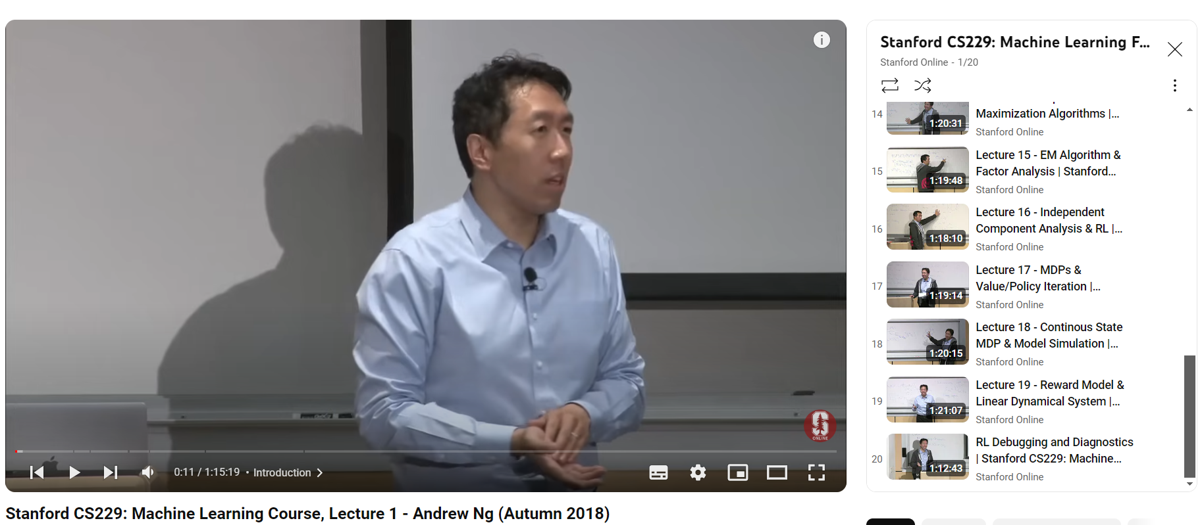
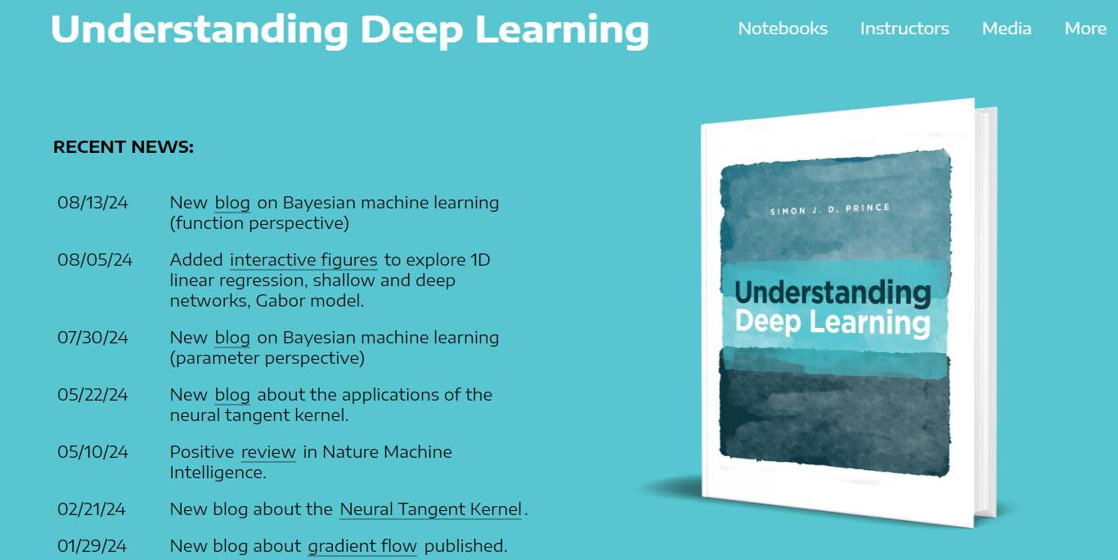
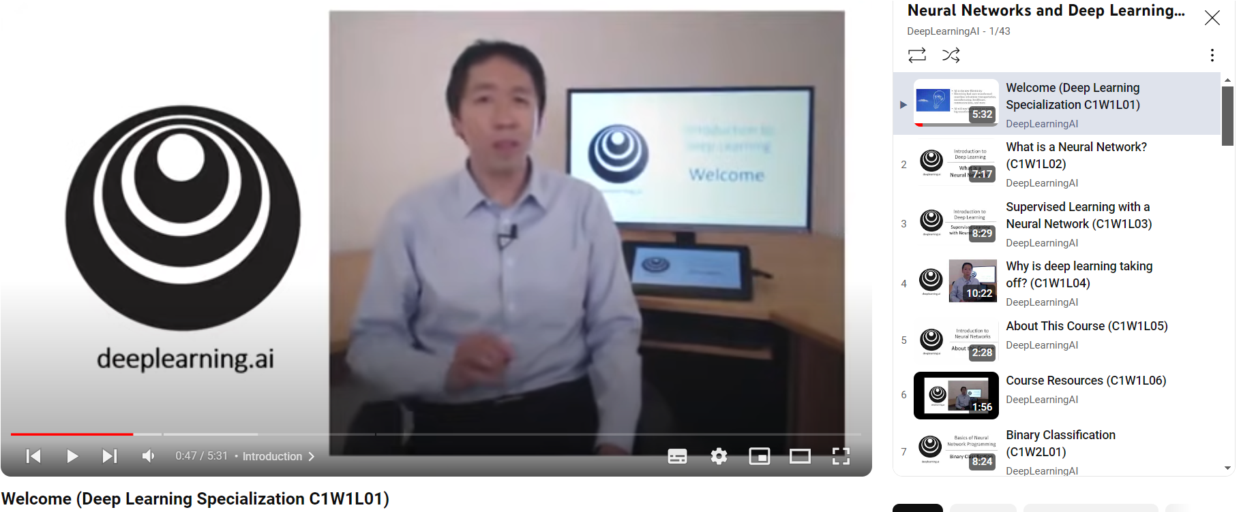
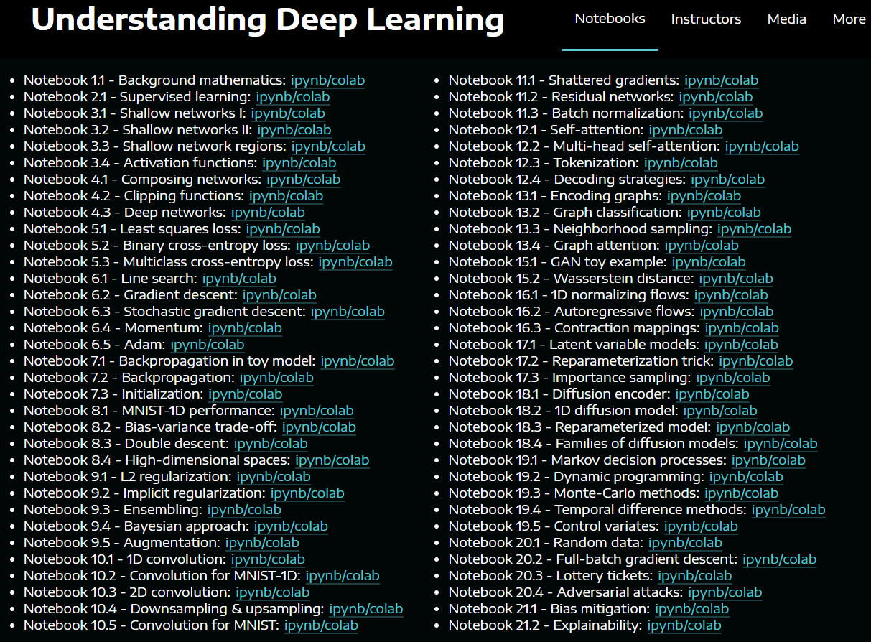
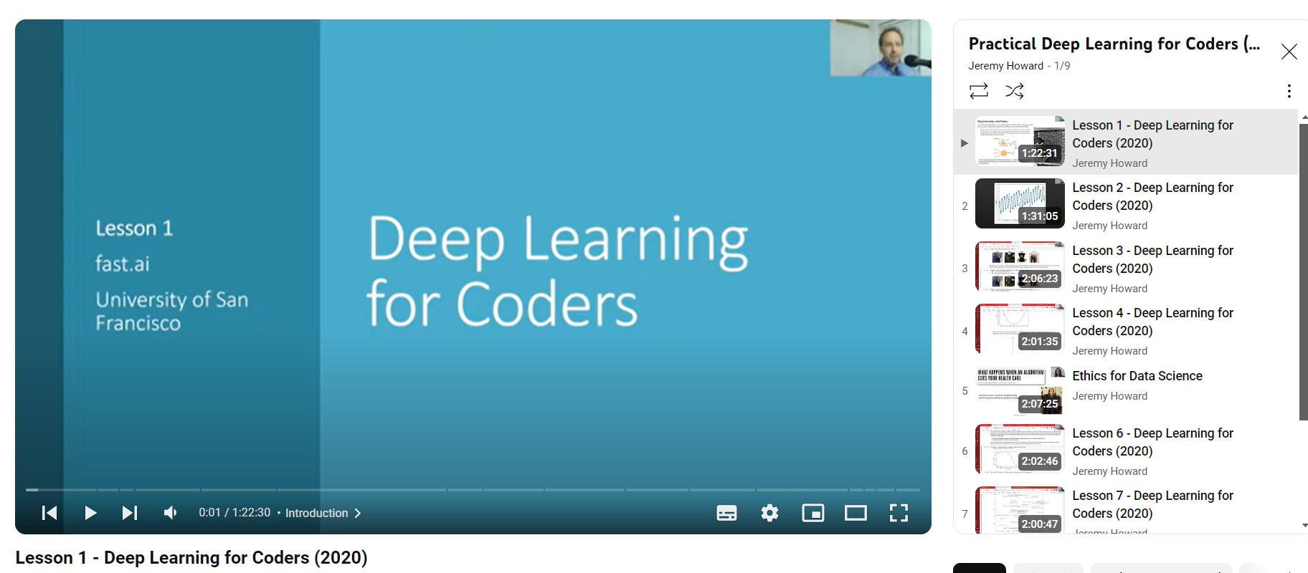
Some good resources to read and learn
d2l.ai:
https://udlbook.github.io/udlbook/ :
Andrew Ng courses and tutorials:
Jeremy Howard – Deep learning for Coders:

Slide 15



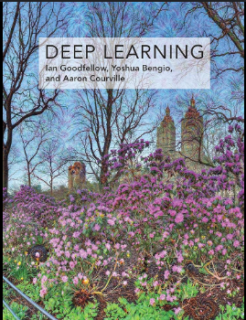
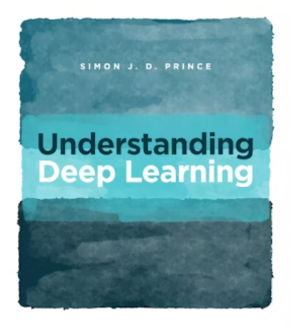
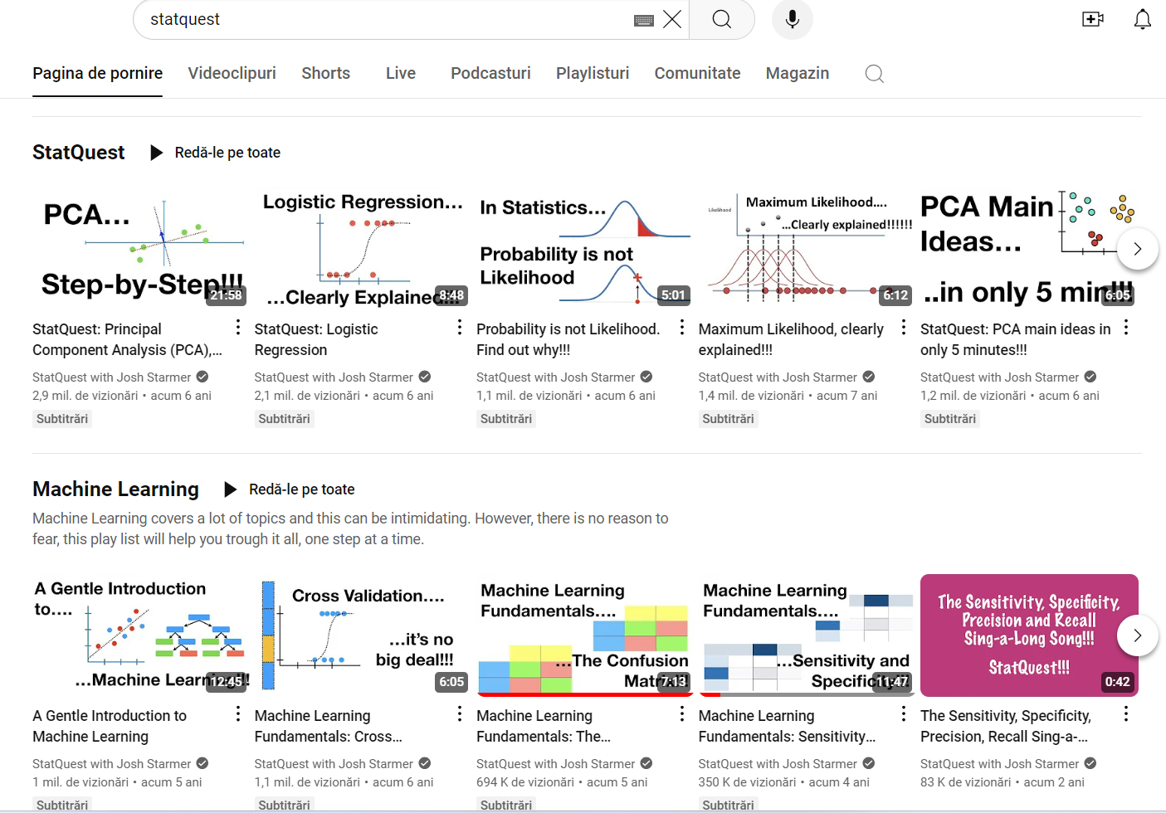
Some good resources to read and learn
Andrej Karpathy and Fei-Fei Li courses:
StatQuest playlists:

Slide 16
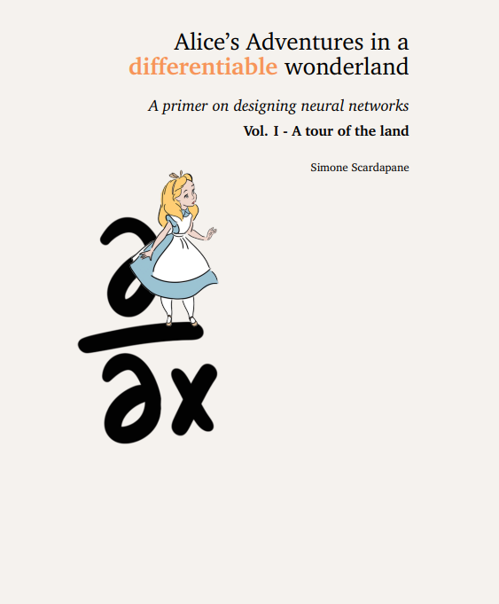
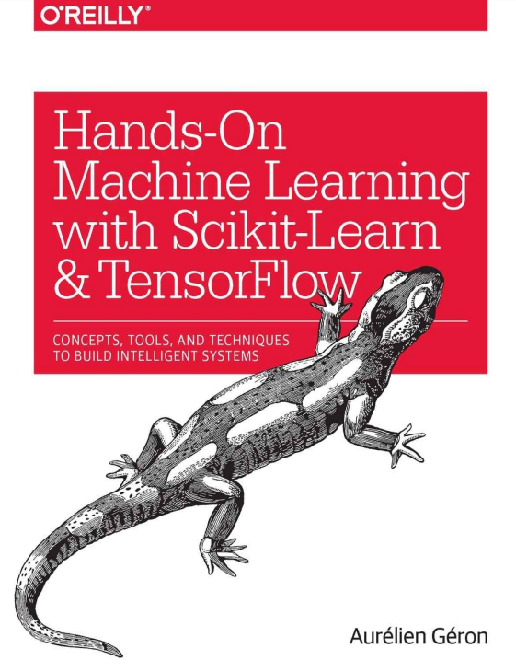

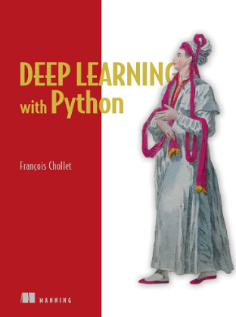
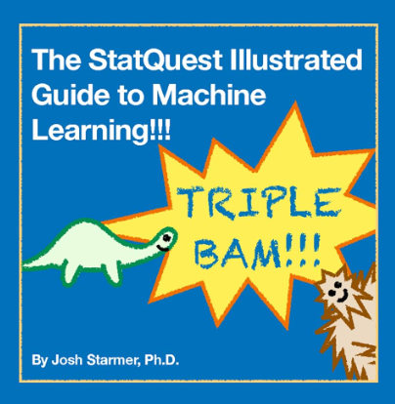
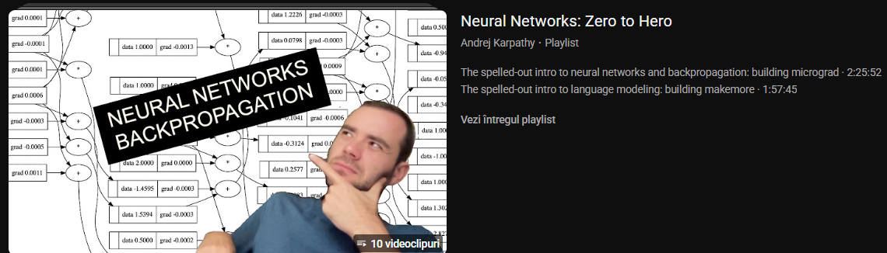
Some good resources to read and learn

Slide 17
Some terminology…

Slide 18
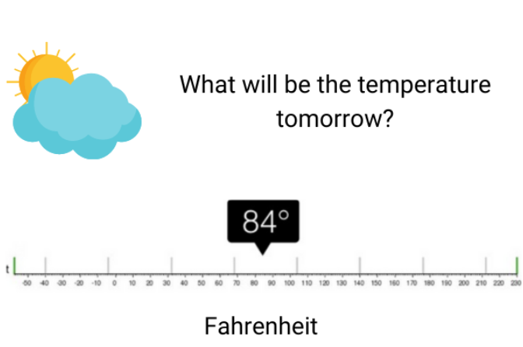
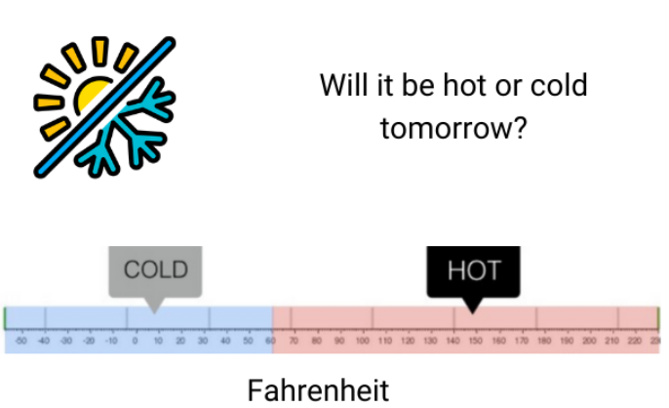
Regression
Classification
aims at predicting a continuous numerical value based on input data.
the output variable in regression is continuous, allowing for a range of possible values.
Example: Predicting tomorrow’s temperature (e.g., 84°F) based on factors like humidity, season, and weather patterns.
the goal is to predict a discrete label or category for a given input data.
the output variable in classification is categorical, meaning it represents distinct classes or groups.
Example: Predicting whether tomorrow will be “hot” or “cold” based on today’s weather conditions.

Slide 19
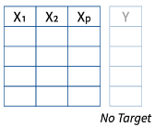
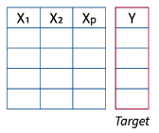


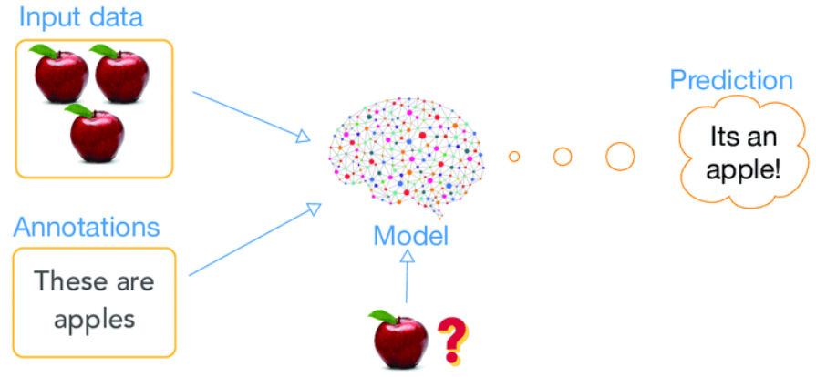
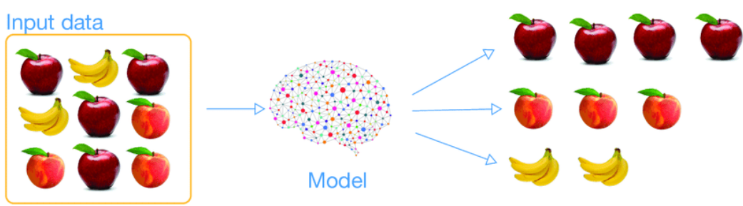
Supervised learning
Unsupervised learning
Supervised learning involves training a model on a labeled dataset, where each training example is paired with an output label.
The model learns to map inputs to the desired output based on these examples.
Common Algorithms: Linear Regression, Logistic Regression, SVM, Decision Trees, Random Forests, Neural Networks (but not all !)
Unsupervised learning deals with unlabeled data.
The model tries to identify inherent patterns, structures, or relationships within the data without predefined labels.
Common Algorithms: K-Means Clustering, Principal Component Analysis (PCA), Autoencoders, etc.

Slide 20
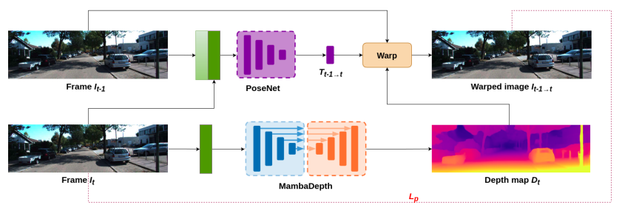
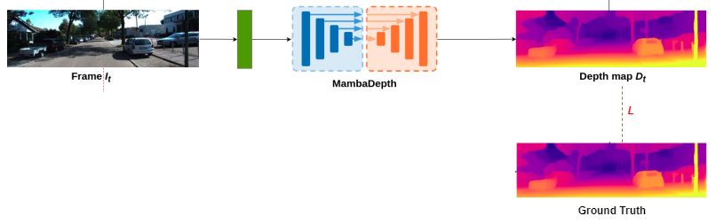

Supervised learning
Unsupervised learning
Example: supervised depth estimation
Example: unsupervised (self-supervised) depth estimation
Requires Ground Truth (GT) depth maps
GT is usually obtained from specialized sensors (e.g., LiDAR, depth cameras), which are expensive, slow, and limited:
Loss = difference between predicted depth and GT depth
Requires only videos
Depth is learned by reconstructing views across frames, no costly GT needed
Loss = difference between real image and warped image (photometric error)
https://arxiv.org/pdf/2406.04532

Slide 21
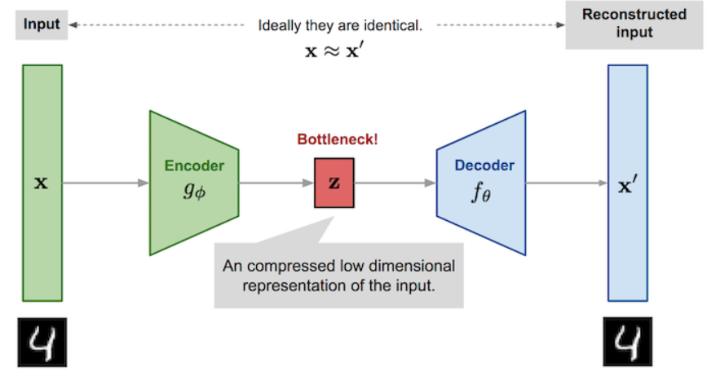
…maybe a simpler example of unsupervised…
Simplifying Data: It learns how to represent complex data in a simpler/compressed form.
Fixing Noisy Data: It can clean up messy or blurry inputs (like images with noise).
Spotting Unusual Cases: It helps detect things that don’t fit the usual pattern (useful for fraud or error detection).
Autoencoder architecture

Slide 22

today’s lab

Slide 23
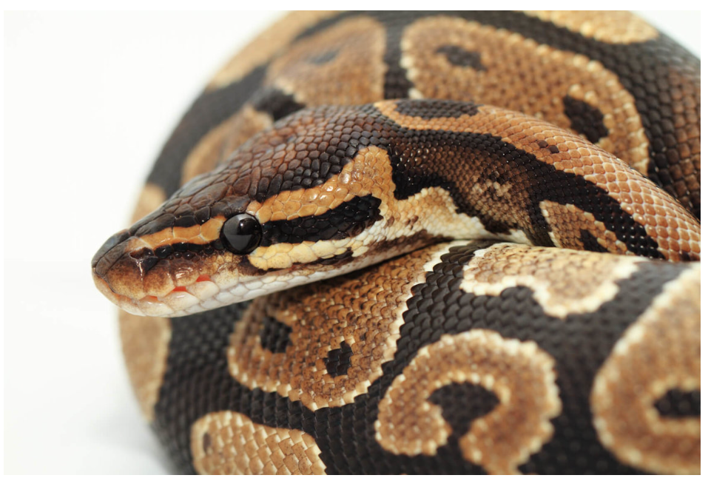
Python Tutorial

Slide 24
Content
Basic data types: numbers, Booleans, strings
Containers: lists, dictionaries, sets, tuples
Functions
Classes
Numpy
Matplotlib

Slide 25
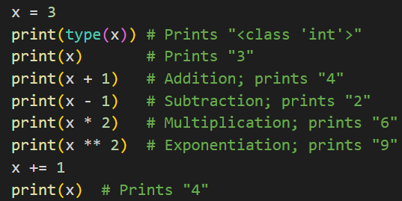
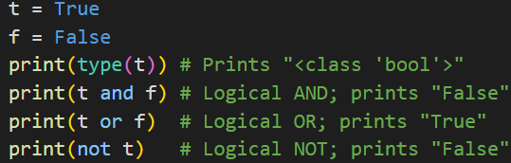
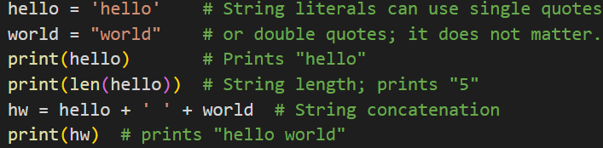
Basic data types
Numbers
Booleans
Strings
TAKEAWAYS: 1) Exponentiation (ridicarea la putere): x**2
2) To check the type: print(type(x))
3) Unlike many languages, Python does not have unary increment (x++) or decrement (x--) operator. Instead we use x+=1 or x-=1.
4) For Boolean logic, Python uses English words (and, or, not) rather than symbols (&&, ||, etc.)

Slide 26
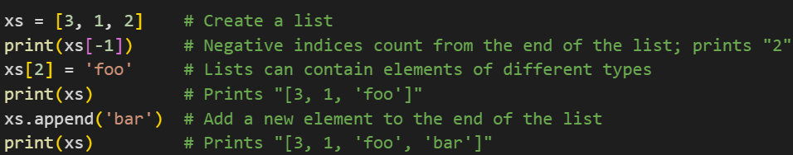
Containers
Lists
Dictionaries
Sets
Tuples
1) Lists: the Python equivalent of arrays, but are resizeable and can contain elements of different types:

Slide 27
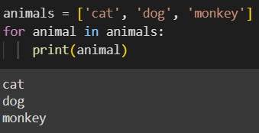
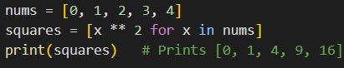


Containers
Lists
Dictionaries
Sets
Tuples
Slicing
Loops
List comprehensions
or

Slide 28

Containers
Lists
Dictionaries
Sets
Tuples
2) Dictionaries: stores (key, value) pairs:

Slide 29



Containers
Lists
Dictionaries
Sets
Tuples
Loops
Dictionary comprehensions
or

Slide 30

Containers
Lists
Dictionaries
Sets
Tuples
3) Sets: an unordered collection of distinct elements:

Slide 31


Containers
Lists
Dictionaries
Sets
Tuples
Loops
Set comprehensions
NOTE: since sets are unordered, you cannot make assumptions about the order in which you visit the elements of the set

Slide 32

Containers
Lists
Dictionaries
Sets
Tuples
4) Tuples: an (immutable) ordered list of values:
NOTE:
IMMUTABLE means that once a tuple is created, its values cannot be changed. You cannot add, remove, or modify the elements in the tuple. This contrasts with lists, which are mutable (changeable).

Slide 33


Functions
Python functions are defined using the def keyword:
optional keyword argument

Slide 34

Classes

Slide 35
Numpy
What is Numpy and why Numpy?
is the core library for scientific computing in Python
using Numpy instead of plain Python lists offers several advantages, especially when working with numerical data and performing mathematical computations:
Efficient Memory Usage
Vectorized Operations
Optimized Libraries

Slide 36

Numpy
the core library for scientific computing in Python
Numpy arrays:
NOTE:
The number of dimensions is the rank of the array; the shape of an array is a tuple of integers giving the size of the array along each dimension.

Slide 37

Numpy
Numpy also provides many functions to create arrays:

Slide 38

Numpy
Every numpy array is a grid of elements of the same type. Numpy provides a large set of numeric datatypes that you can use to construct arrays:

Slide 39



Numpy
Slicing and indexing:

Slide 40




Numpy
Basic mathematical functions:
transposing operation:
sum operation:
NOTE:
unlike MATLAB, * is elementwise multiplication, not matrix multiplication. We instead use the dot function to compute inner products of vectors, to multiply a vector by a matrix, and to multiply matrices.

Slide 41





Numpy
NOTE:
unlike MATLAB, * is elementwise multiplication, not matrix multiplication. We instead use the dot function to compute inner products of vectors, to multiply a vector by a matrix, and to multiply matrices.

Slide 42



Numpy
Broadcasting is a powerful mechanism that allows numpy to work with arrays of different shapes when performing arithmetic operations.
Frequently we have a smaller array and a larger array, and we want to use the smaller array multiple times to perform some operation on the larger array:
All equivalent!

Slide 43



Matplotlib
a plotting library
matplotlib.pyplot module provides a plotting system similar to that of MATLAB.

Slide 44
How we will work at the laboratory?

Slide 45


We will use Google Colab (you need just a gmail to have the notebooks saved in Google Drive)
this is the laboratory from Campus

Slide 46


for laboratories and tests we will work in new notebooks

Slide 47



we can create any code cells we want (ideally it would be nice to have more cells for a single problem such that to be easier to debug the code ☺)
if we don’t know exactly what a function does or what are its parameters, we can easily put the mouse over the name of the function, and then we will see a popup with a description for that function and some examples (if we scroll down a bit)

Slide 48
Exercises

Slide 49


Slide 50

Solutions

Slide 51


Slide 52


Slide 53
Thank you !

